Slide 1

Case Study
Hybrid theory
BBA 1st SEM (2022-23)
Submitted By-
Shankh Bansal
AU22C1013
Submitted To-
Dr. Meenal Sharma

Slide 2

Hybrid Working Model?
The hybrid work model is a business model that combines a mixture of both remote and office work.
It creates a flexible work schedule.
Employees have the freedom to divide their time between working at home and coming into a physical office.

Slide 3

The Difference Between Hybrid and Remote Work
The hybrid workplace model combines employees who work from the company office with employees who work from home. Here’s how the two work models differ from each other

Slide 4


Work Environment
Hybrid
Remote
Being more flexible, employees can choose whether they want to work remotely or in an office environment in a hybrid team.
In a remote organization, all professionals invariably work outside of a conventional office environment.

Slide 5

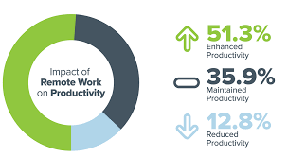
Productivity
Hybrid
Remote
In the hybrid approach, choosing the work environment significantly improves employee productivity.
Only those employees who can adapt well to remote working can have better productivity. And not everyone can perform well at their home office as they would have in an actual office.

Slide 6


Communication
Hybrid
Remote
A hybrid company needs to create policies ensuring all information is passed uniformly to the in-office and remote teams.
Since all employees work remotely, the organization already has a consistent network to communicate all information.

Slide 7

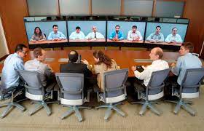
Team Meetings
Hybrid
Remote
In a hybrid team, the meetings can happen virtually or sometimes in the office.
In a remote company, the meetings are usually virtual and held via video conferencing apps such as Skype, Zoom, Teams, etc.

Slide 8

Benefits of Hybrid Model
Increased Productivity
Improved Employee Satisfaction
Reduced Business Costs
Decreasing employee turnover
Greater retention

Slide 9

Drawbacks of Hybrid Model
Harder to collaborate with remote employees.
Requires oversight and maintenance to keep it working.
Not suitable for all industries.

Slide 10


Requirements for Successful Hybrid Model
Empathy
Collaboration
Change management
Communication with employees
Connection between remote & hybrid employee.

Slide 11

Conclusion
The hybrid work model might be an undeniable arrangement for many organizations in the future. But now that you have a clearer picture of the benefits of the hybrid work model, think about what works best for your organization’s unique circumstances and employees.

